Slide 1


Slide 2
C# Day 2 Lecture12: Form Design

Slide 3
Form Design: MessageBox
using System;
using System.Text;
using System.Windows.Forms;
public class HelloWorld
{
public static void Main()
{
MessageBox.Show("Hello World!");
}
}

Slide 4
Form Design: TextBox
private void button1_Click(object sender, EventArgs e)
{
text1.Text = textBox1.Text.ToString();
text2.Text = textBox2.Text.ToString();
MessageBox.Show("You've successfully logged in.","Log in");
}

Slide 5
Form Design: Label
private void button1_Click(object sender, EventArgs e)
{
label1.Text = label1.Text.ToString().ToUpper();
label2.Text = label2.Text.ToString().ToLower();
MessageBox.Show("You've successfully logged in.","Log in");
}

Slide 6
Form Design: CheckBox
private void checkBox1_CheckedChanged(object sender, EventArgs e)
{
if(checkBox1.Checked)
textBox2.UseSystemPasswordChar = false;
else
textBox2.UseSystemPasswordChar = true;
}
}

Slide 7
Form Design: CheckBox
private void button1_Click(object sender, EventArgs e)
{
textBox1.Text = textBox1.Text.ToString();
textBox2.Text = textBox2.Text.ToString();
MessageBox.Show("You've successfully logged in.","Log in");
}
private void checkBox1_CheckedChanged(object sender, EventArgs e)
{
if (checkBox1.Checked)
{ textBox2.UseSystemPasswordChar = false; }
else
{ textBox2.UseSystemPasswordChar = true; }
}

Slide 8
Form Design: RadioButton
string radio="radio";
private void radioButton1_CheckedChanged(object sender, EventArgs e)
{
radio = "Button1";
}
private void radioButton2_CheckedChanged(object sender, EventArgs e)
{
radio = "Button2";
}

Slide 9
Form Design: PictureBox
private void pictureBox1_Click(object sender, EventArgs e)
{
pictureBox1.SizeMode.GetType();
}

Slide 10
Windows Form Design
Let's design a Form.

Slide 11
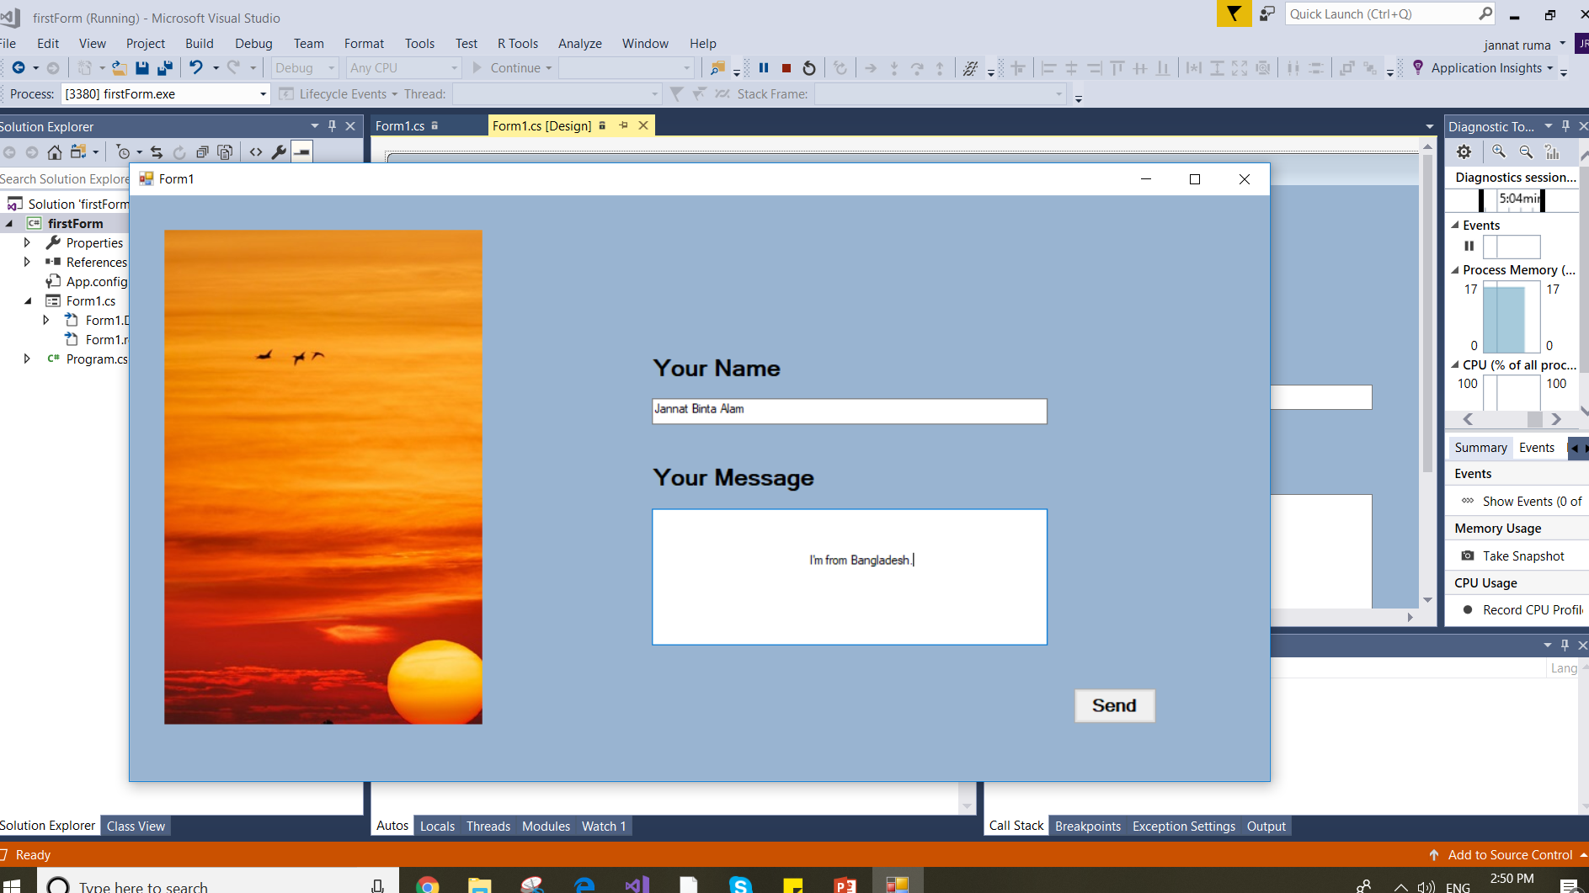

Slide 12
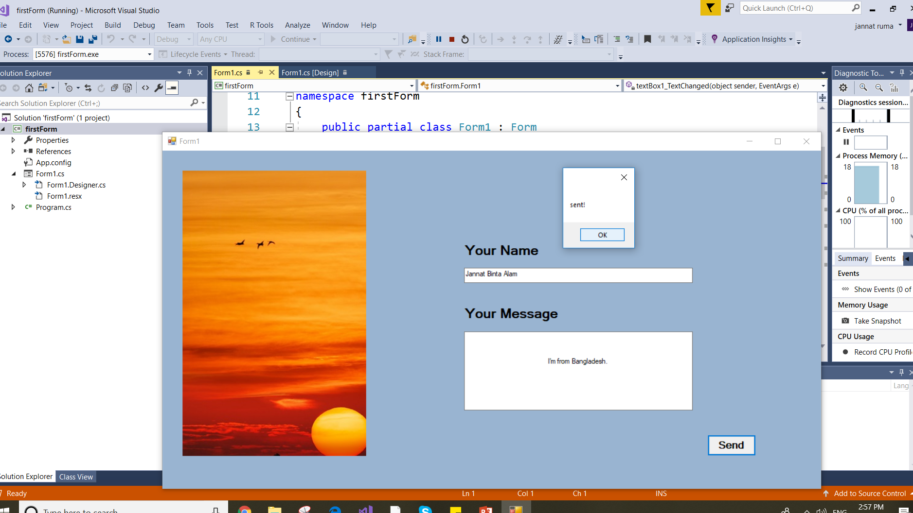

Slide 13
Windows Form Design: Make PDF
Write some code to generate a PDF.
Hint:
First design a form
Use some methods

Slide 14
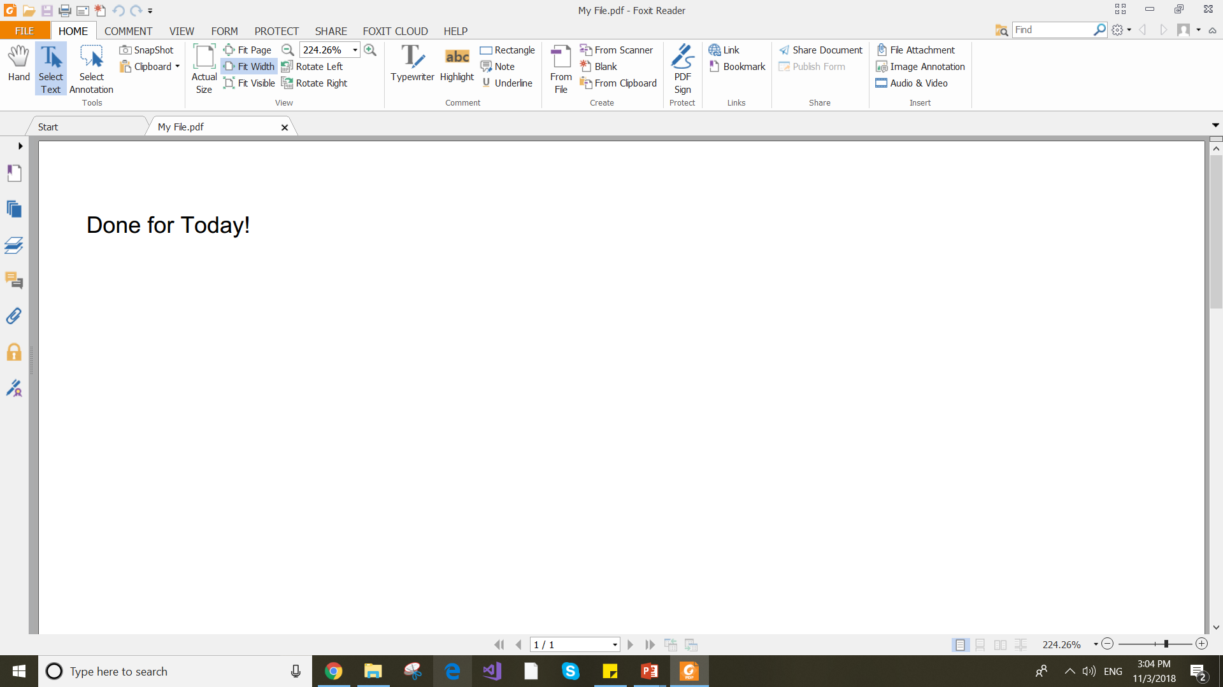
Windows Form Design: Make PDF

Slide 15
Windows Form Design: Make PDF
using System.IO;
using iTextSharp.text;
using iTextSharp.text.pdf;
private void button1_Click(object sender, EventArgs e)
{ Document doc = new Document(iTextSharp.text.PageSize.LETTER, 25, 25, 30, 20);
PdfWriter myPDF = PdfWriter.GetInstance(doc, new FileStream(textBox1.Text.ToString() + ".pdf", FileMode.Create));
Paragraph pri = new Paragraph(textBox2.Text.ToString());
doc.Open();
doc.Add(pri);
doc.Close();
MessageBox.Show("Saved");
}

Slide 16
This slide is provided as a course material in the workshop named “Workshop on C# Programming: Learn to Build”.
Organized by-
East West University Computer Programming Club (EWUCoPC)
Prepared by- Jannat Binta Alam
Campus Ambassador
Young Engineers Society (YES)
E-mail: jannat.cse.ewu@gmail.com

